Slide 1
Feature Point Detection
Now & Then: A historic mosaic using Harris Stephens Corner Detector and the SIFT feature descriptor
By
Anisa Zhurda & Rabbir Bin Rabbani

Slide 2
Introduction
We all like feeling nostalgic and nothing brings more nostalgia then a look into the past with photos and comparing it to the present.
We used Sören Weber's collection (https://www.boredpanda.com/then-and-now-pictures-changing-world-rephotos/).
We selected some of the images from his gallery and cropped them so that we would have a higher chance to match feature points and give desirable results.

Slide 3
Methodology
Find Corner Points (Harris Stephens Corner Detector).
Find Descriptors of the Corner Points (SIFT DESCRIPTOR).
Find matching points (using Lowe's Ratio Test).
Use RANSAC to randomly sample several homographies of the 'now' image, that best fit the 'then' image.
Generate the mosiac of the 'then' image on top of the homographically projected 'now' image.

Slide 4
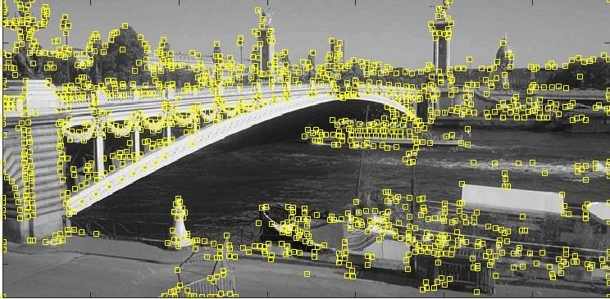
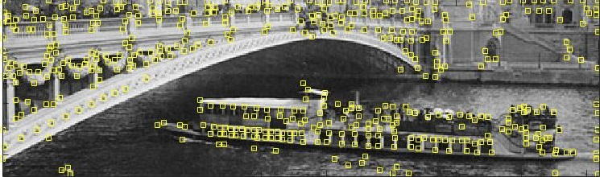
Harris Corner Detector Output

Slide 5
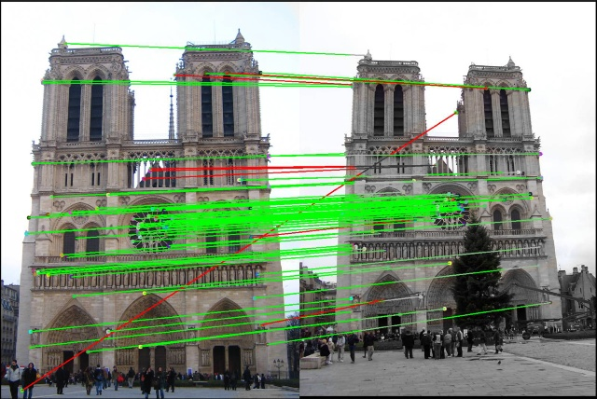
Output after finding matching SIFT points

Slide 6
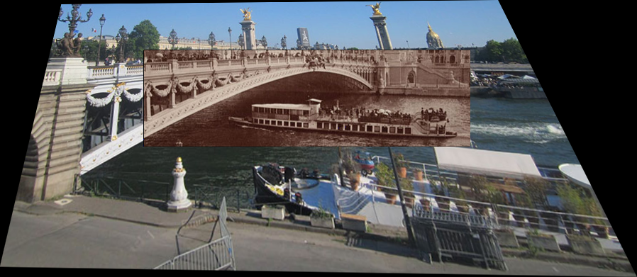
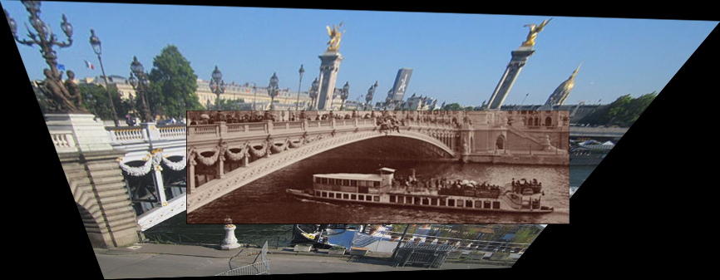
Outputs for different parameter combinations

Slide 7
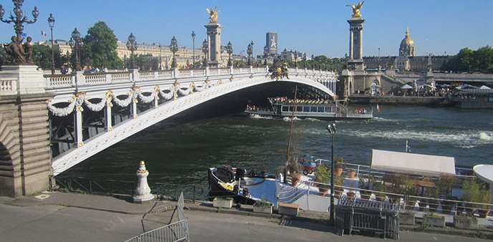
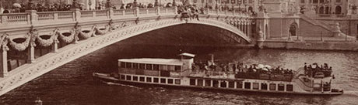
Example 1 - Inputs
Paris, France 2017(Left) & 1900 (Right)

Slide 8
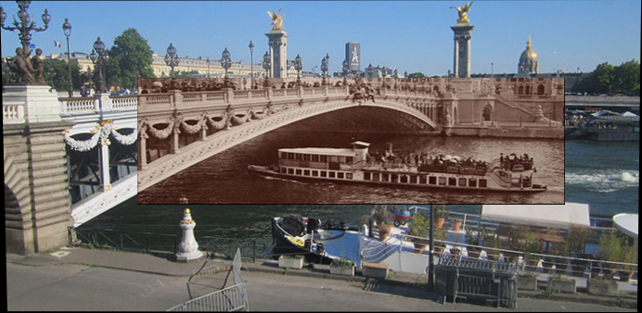
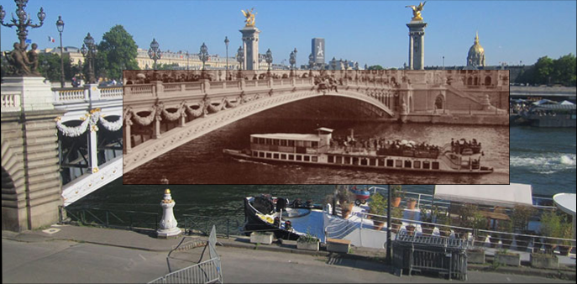
Example 1 - 'Good' Outputs

Slide 9
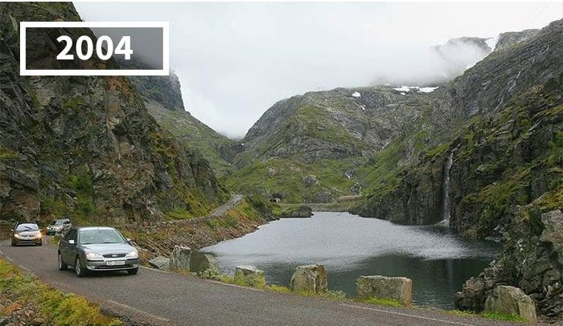
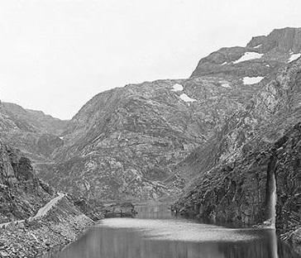
Example 2 - Inputs
Seljestadjuvet, Odda, Norway, 2004(Left) & 1887 (Right)

Slide 10
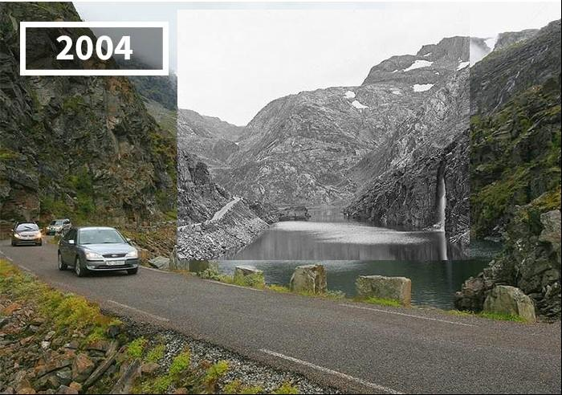
Example 2 - 'Good' Output

Slide 11
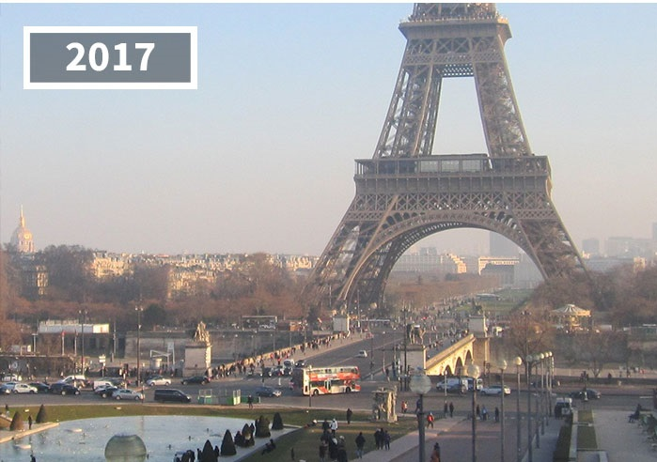
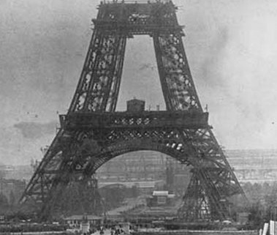
Example 3 - Inputs
Paris, Eiffel Tower 2017(Left) & 1888 during construction (Right)

Slide 12
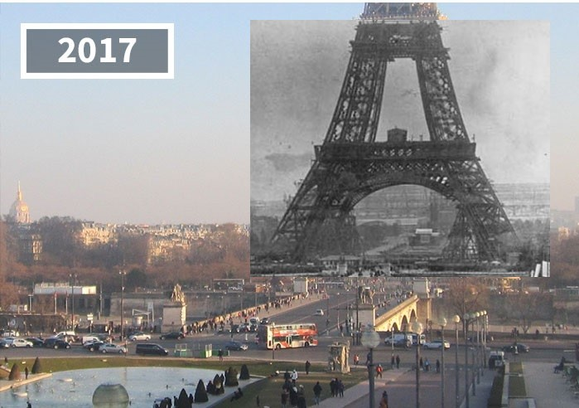
Example 3 - 'Good' Output

Slide 13
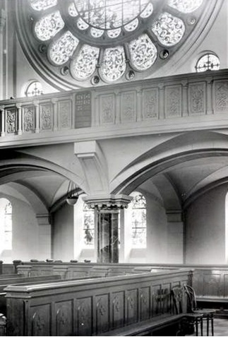
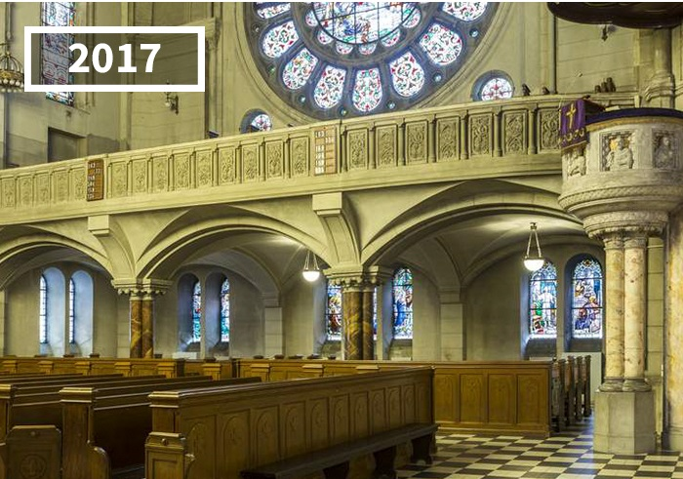
Example 4 - Inputs
St. Matthew Evangelical Church, Poland, 2017(Left) & 1937 (Right)

Slide 14
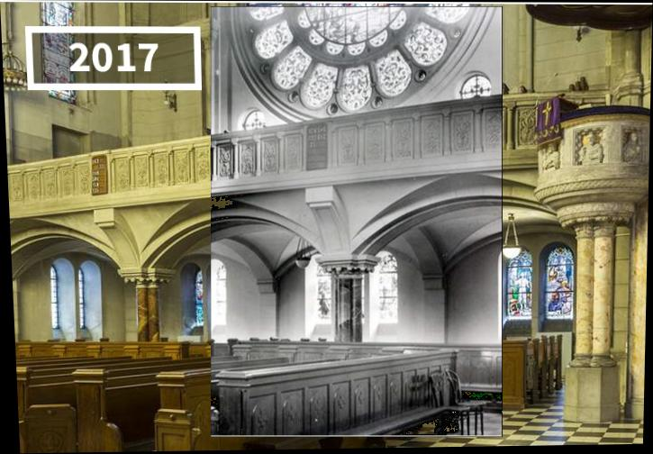
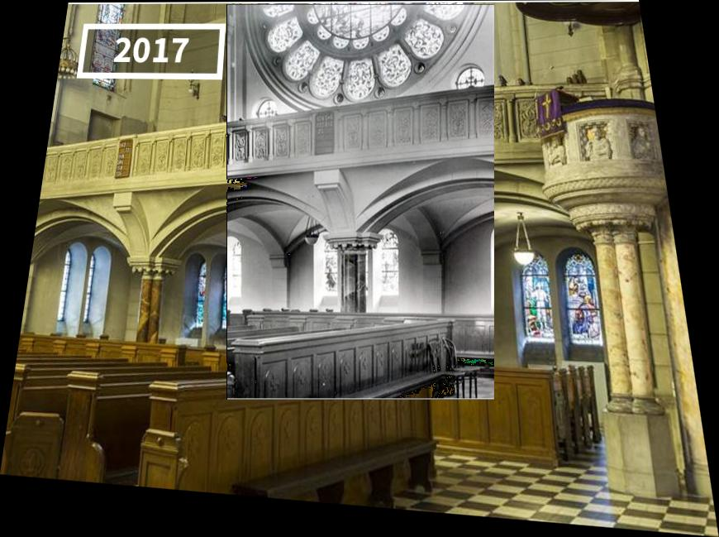
Example 4 - 'Good' Outputs

Slide 15
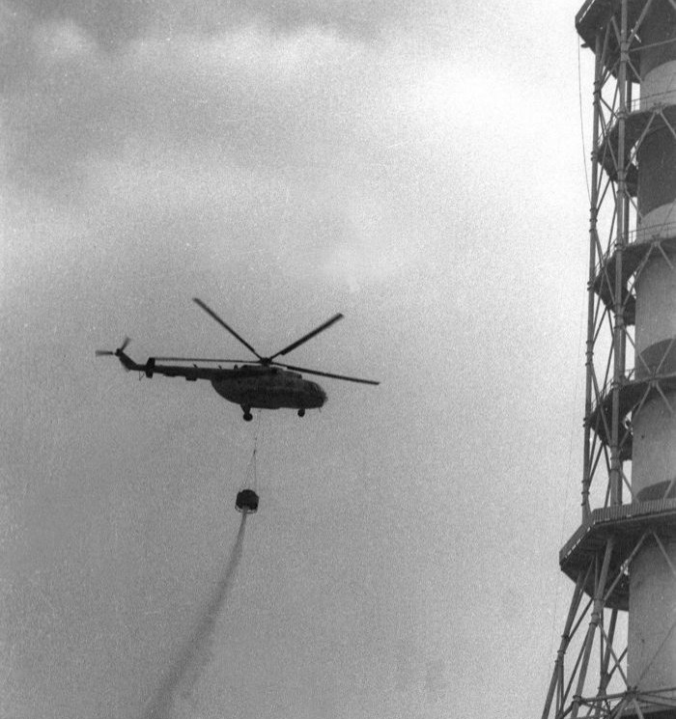
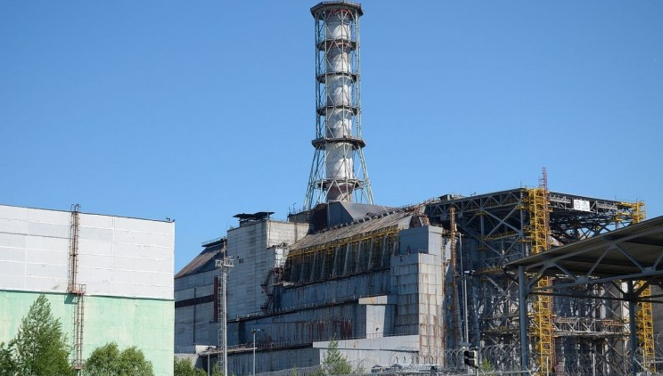
Example 5 - Inputs
Chernobyl Reactor, 2006(Left) & 1986 (Right)

Slide 16
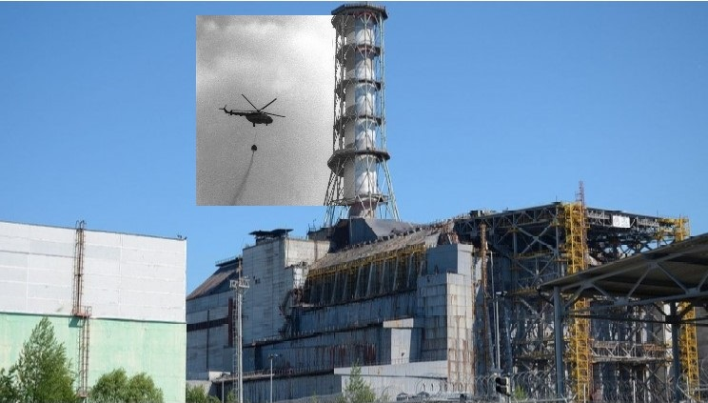
Example 5 - 'Good' Output

Slide 17
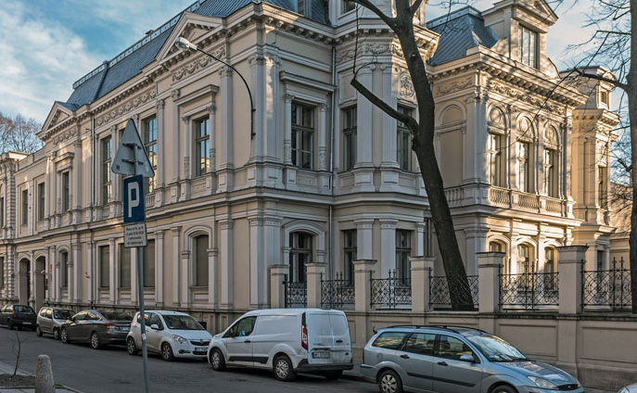
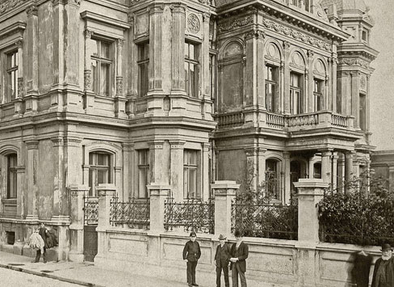
Example 6 - Inputs
Building in Lodz, Poland, 2015(Left) & 1987 (Right)

Slide 18
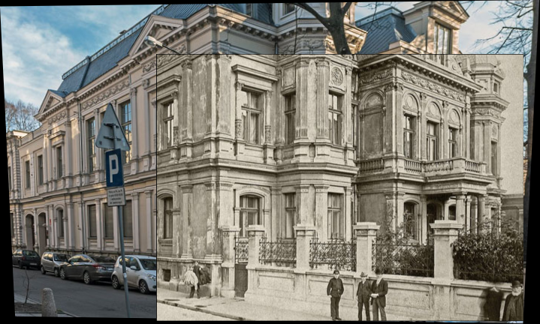
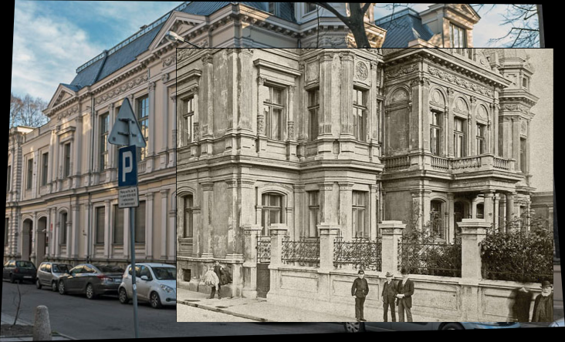
Example 6 - 'Good' Outputs

Slide 19
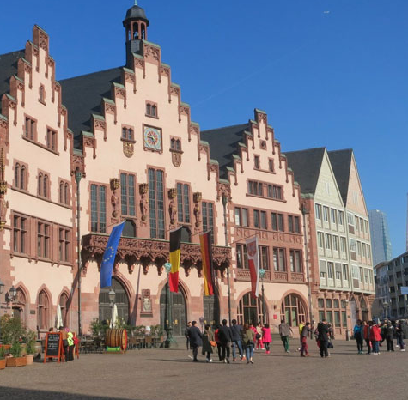
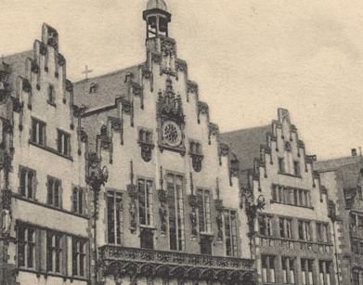
Example 7 - Inputs
Römerburg, Frankfurt, Germany, 2017(Left) & 1910 (Right)

Slide 20
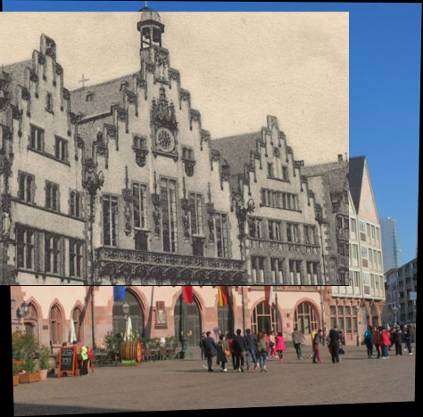
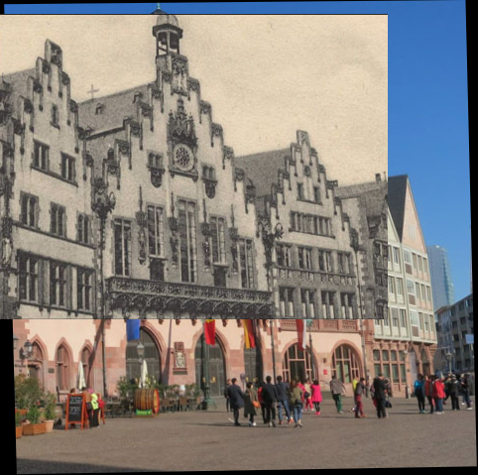
Example 7 - 'Good' Outputs

Slide 21
Challenges and Irregular Outputs
Some changes between images are really extreme, and comparison in terms of corner features is not viable.
Some image pairs can also look very similar to our human eyes but they can have many feature points that we could overlook at a moment's notice.
As expected, each pair of images had its own 'good' parameter combination and had to be processed separately.
To find this combination or combinations of 'good' parameters we had to do a brute force parameter tuning.
This led to a very portion of the outputs to have a 'good' output.
Which, conversely, means that a big portion of the resulting images are very irregular or unexpected.

Slide 22
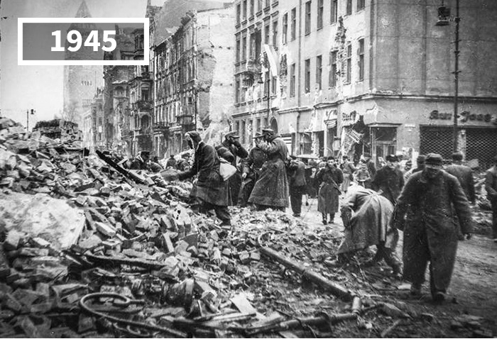
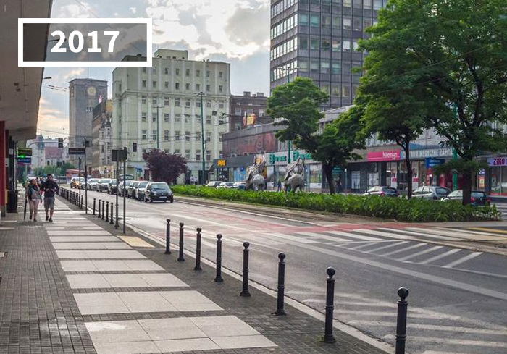
Challenging Inputs Part -1
Pictures taken from the same spot. But they are completely different.

Slide 23
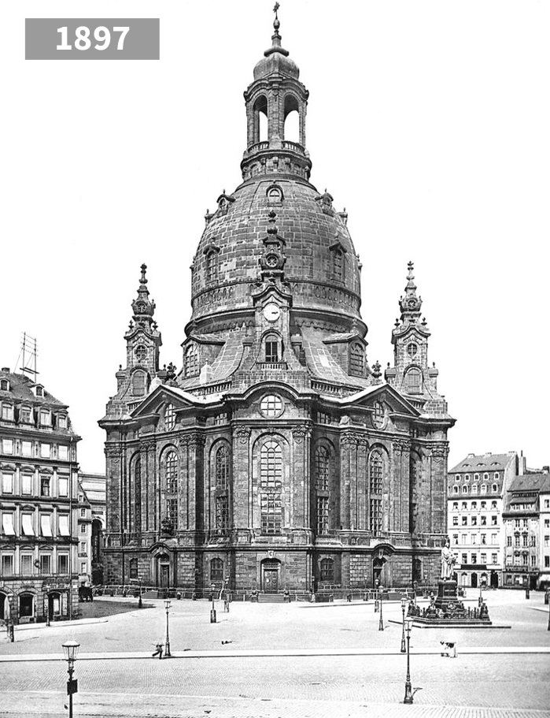
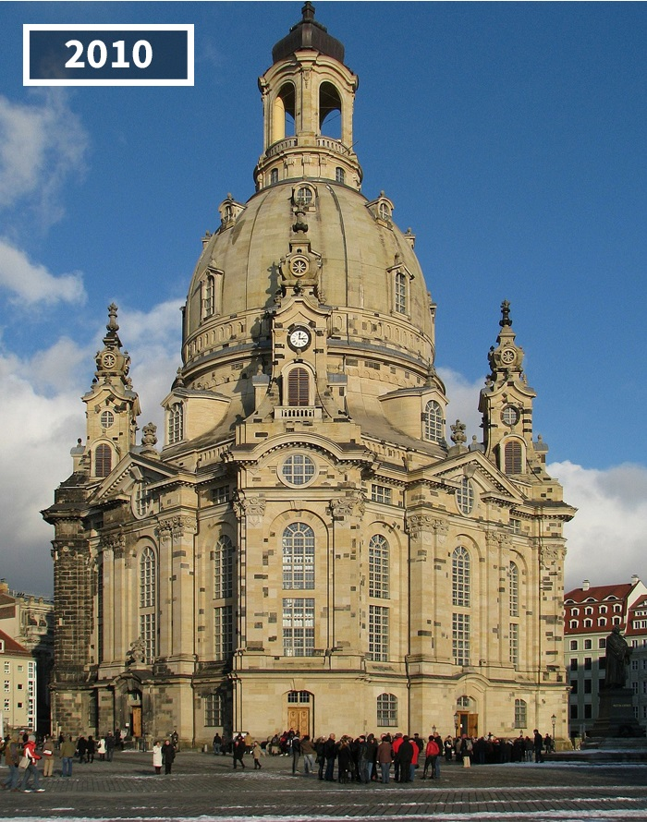
Challenging Inputs Part -2
Pictures are in almost the same angle. But the one on the left has a lot more corner points due to the visible brick pattern compared to the smooth exterior of the right.

Slide 24
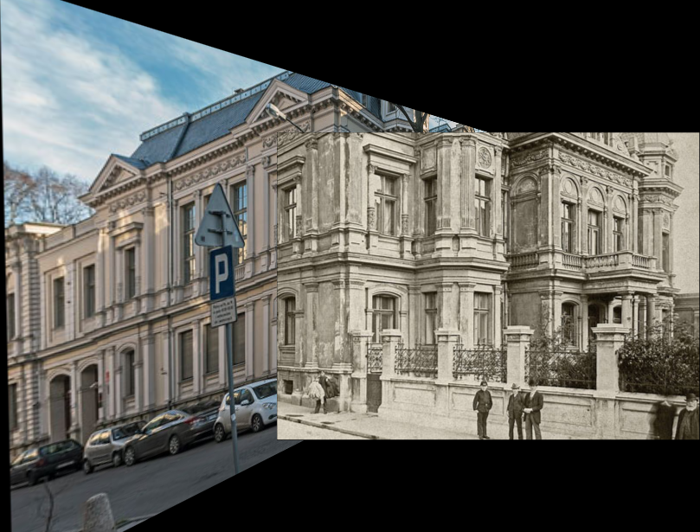
Irregular output Case 1

Slide 25
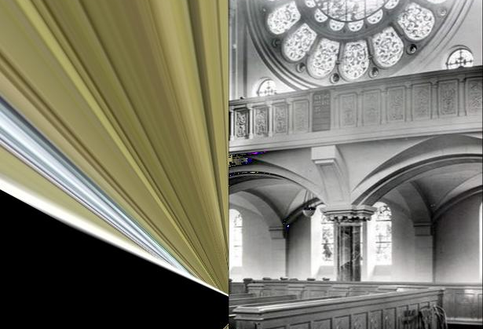
Irregular output Case 2

Slide 26
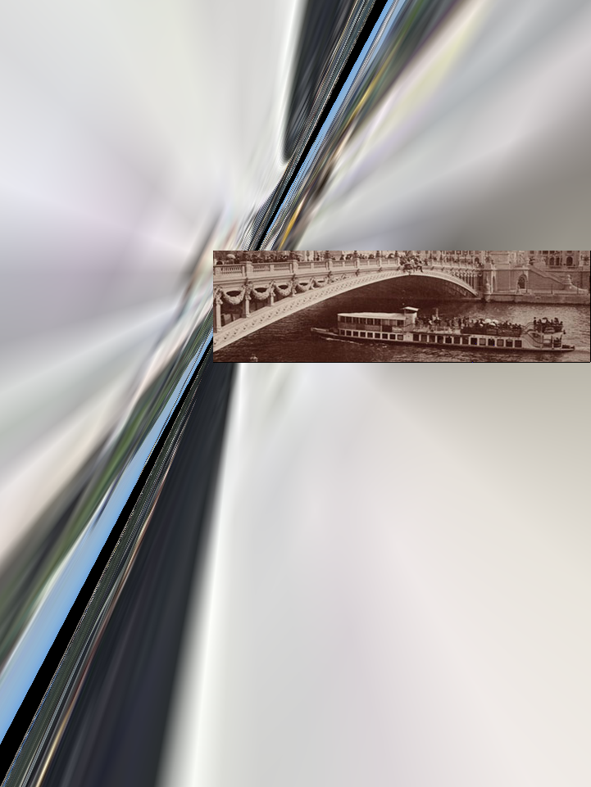
Irregular output Case 3

Slide 27
Limitations in Implementation
The system takes a folder of two images. Any images after the first two images in the folder will be ignored by this implementation.
The system is only able to use two images as our use case only uses a set of two images.
This implementation expects the newer or 'now' image before the older or 'then' image in the folder. So, it attempts to put the second image in the folder over the first image provided that there are matching points.

Slide 28
Further Work
Using SURF instead of SIFT (Execution would be faster but out of scope for this project).
Using RANSAC on the homography of both images instead of just the 'now' image.
Mosiac/Stitching of several 'then' image parts to the 'now' image.

Slide 29
Thank You

Slide 32
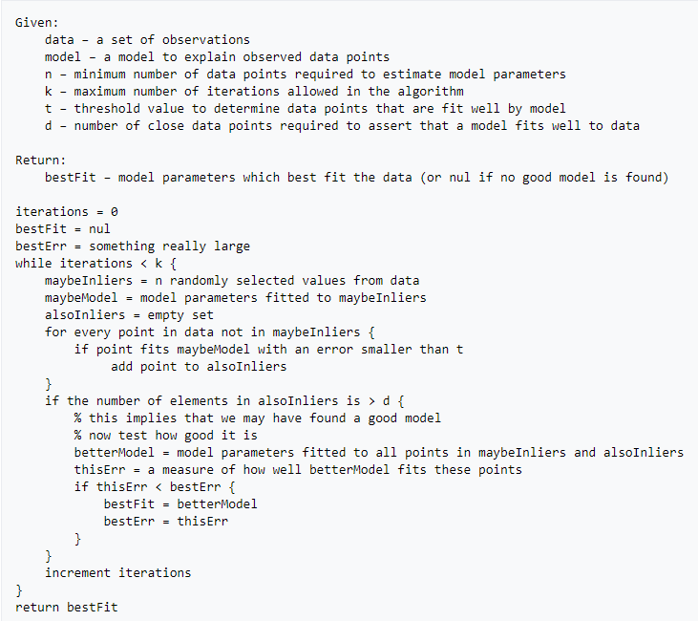
RANSAC Algorithm

